Slide 1





By: Stephany Apodaca
An Applied Research Study on Professional Development for Improving Classroom Management Strategies
Notes:
Hello, my name is Stephany Apodaca, and this is An Applied Research Study on Professional Development for Improving Classroom Management Strategies.

Slide 2
Research Topic
Alignment to Curriculum and Instruction
Instructional Improvement Strategies
Classroom Management Practices
Importance of Professional Development relevant to this topic
Notes:
This research focuses on the connection between instructional improvement strategies and classroom management practices within the field of curriculum and instruction. Effective classroom management is essential for maximizing instructional time and ensuring the successful delivery of the curriculum. When teachers implement clear expectations, routines, and data-driven strategies, they create structured learning environments that increase student engagement, independence, and understanding. Professional development plays a critical role in strengthening these skills by equipping teachers with the tools and confidence needed to manage classrooms effectively while enhancing instructional practices. Ultimately, strong classroom management supports meaningful learning by enabling teachers to focus on delivering high-quality instruction in a safe, productive environment.

Slide 3
Research Problem Statement
Problem Statement
Primary Causes
Impact of Challenges
Notes:
Many teachers feel underprepared to manage classroom behavior effectively, limiting their ability to deliver high-quality instruction and support student achievement. This challenge is often caused by insufficient classroom management training and limited access to consistent, evidence-based professional development, leaving teachers without the skills and confidence to establish structured, productive learning environments. Additionally, inconsistent implementation of management strategies and competing instructional demands make it difficult to sustain effective practices. As a result, classrooms may experience increased disruptions, reduced instructional time, and lower student engagement, ultimately impacting academic performance and overall school climate.

Slide 4

Research Question
Research Question
Gaps that are Addressed
Alignment with the Applied Research Design
Alignment with the field of Curriculum and Instruction
Notes:
This study is guided by the research question: How can a professional development program focused on classroom management strategies be developed to support teachers in implementing effective instructional practices? This question addresses key gaps in teacher preparedness and the need for consistent, research-based professional development, while recognizing the strong connection between classroom management and instructional improvement. It aligns with an applied research design by focusing on the creation of a practical, solution-oriented product—a professional development program that can be implemented in real educational settings. Additionally, the question is closely connected to the field of curriculum and instruction, as it aims to strengthen teachers’ ability to deliver curriculum effectively by improving classroom structure, increasing student engagement, and supporting overall learning outcomes.

Slide 5
The Product
Justification of the product’s necessity
Product accomplishments
The study’s contribution to the field of curriculum and instruction
Notes:
This capstone research is justified by the ongoing need to better support teachers in developing effective classroom management skills that directly strengthen instructional practice. Because classroom management is essential to successful curriculum implementation, educators must be equipped with practical, research-based professional development that moves beyond theory and focuses on real classroom application. Without structured and well-managed learning environments, even strong curriculum design cannot be fully effective. The proposed product—a professional development program—addresses these needs by bridging the gap between knowledge and practice. Grounded in data and teacher experiences, it is designed to support consistent routines, clear expectations, and proactive management strategies. In doing so, it promotes increased teacher confidence and professional growth while helping create classrooms that foster student independence, engagement, and academic success. Overall, this study contributes to the field of curriculum and instruction by offering a practical, research-based solution that enhances instructional effectiveness and maximizes learning time. It supports more consistent teaching practices across classrooms and reinforces the critical role of classroom management in improving both instructional delivery and student outcomes.

Slide 6
The Methodology
Research design/Survey
Quantitative Data
Qualitative Data
Notes:
This study uses a mixed-methods research design that combines both quantitative and qualitative approaches to provide a more complete understanding of the research problem. The quantitative component consists of closed-ended survey questions that collect numerical data on teachers’ confidence levels, perceived preparedness, and the frequency of classroom management strategy use. This data helps identify patterns, trends, and overall areas of need across participants. The qualitative component includes open-ended survey questions that gather detailed, descriptive responses about teachers’ experiences, challenges, and professional development needs related to classroom management and instruction. This allows for a deeper understanding of the context behind the numerical data and highlights the real-world factors that influence teacher effectiveness. Together, both data sources provide a well-rounded perspective by combining measurable trends with rich, descriptive insights, ensuring the findings are both evidence-based and grounded in teacher experience.

Slide 7
Data Collection and Analysis Methods
Quantitative Data
Qualitative Data
Rubric
Timeline
Notes:
This study uses a structured data collection and analysis process that includes quantitative data, qualitative data, a rubric-based coding system, and a defined timeline. For the quantitative data, closed-ended survey responses will be analyzed using descriptive statistics, including frequencies, percentages, and means. This will help identify patterns in teachers’ perceived preparedness, confidence levels, and professional development experiences, highlighting key areas of need. For the qualitative data, open-ended responses will be analyzed through thematic analysis to identify recurring patterns in teachers’ experiences, challenges, and professional development needs. These responses will also be further organized using a rubric-based coding system that categorizes data into clear domains, such as teacher preparedness, classroom management strategies, and perceived effectiveness of professional development. This adds structure and consistency to the interpretation of qualitative findings. Finally, the data collection will take approximately three to four weeks. Week one focuses on approvals and participant recruitment; weeks two and three involve survey distribution and completion, with reminders to support participation; and week four includes closing the survey and organizing all data for analysis. This timeline ensures an organized, efficient, and manageable process that supports strong participation and reliable data collection.

Slide 8
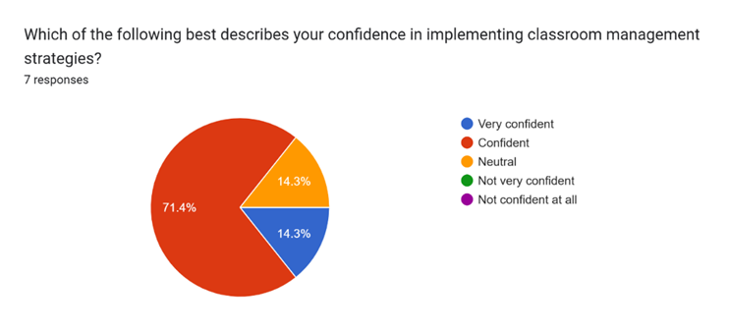
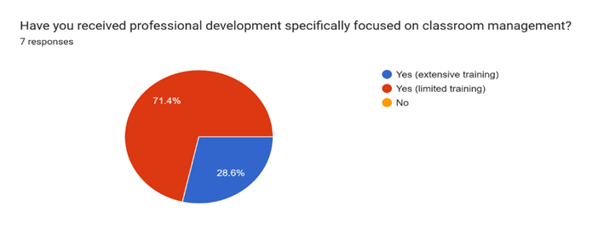
Data for confidence in implementing classroom management strategies
Notes:
When we look at the data and the graphs from this study, we can see a clear connection between the amount of professional development teachers have received and their confidence in classroom management. The graph shows that 71.4% of participants reported limited training, which aligns closely with the finding that 71.4% of teachers felt only somewhat confident in their classroom management abilities. In contrast, only 28.6% of teachers reported receiving extensive professional development, and within the confidence data, just 14.3% felt highly confident. This suggests that higher levels of training may be linked to stronger confidence, but that only a small portion of teachers have had access to that level of support. Overall, the data and graphs together highlight a clear pattern: teachers with less professional development tend to feel less confident, while those with more training tend to feel more confident. This reinforces the importance of providing consistent, high-quality professional development opportunities to help teachers build both their skills and their confidence in managing the classroom effectively.

Slide 9
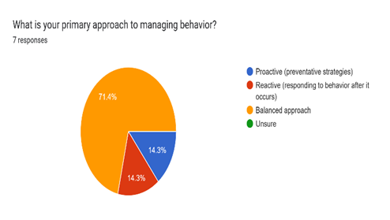
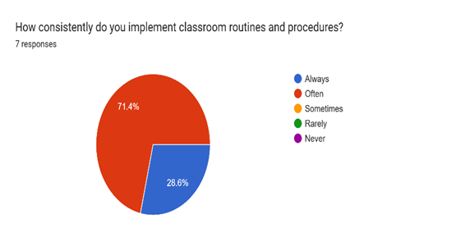
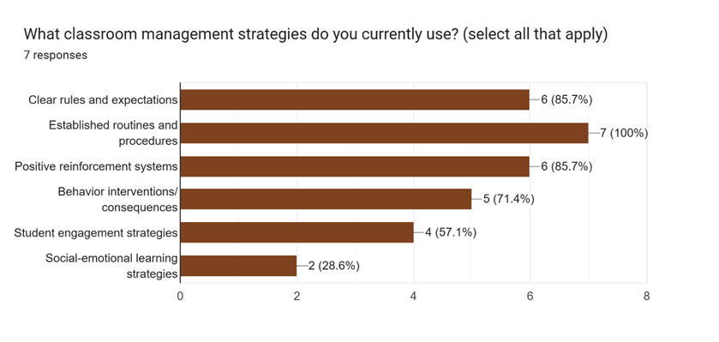

Data on How Teachers Implement Classroom Management Strategies
Notes:
When we look at the data on classroom management strategies currently being used, a few important patterns stand out. Teachers reported that social-emotional learning and student engagement strategies were areas of concern, meaning these were not being used as confidently or consistently as other strategies. In contrast, 100% of participants expressed confidence in their ability to establish rules and procedures, which shows a strong foundation in basic classroom structure. Teachers also reported using classroom management strategies consistently or often. However, when we compare this to the graph showing their overall approach to behavior management, we see a clear discrepancy. Even though strategies are frequently used, 85.7% of teachers identified their approach as primarily reactive or a mix of reactive and proactive methods. This suggests that while teachers are implementing strategies, many of those strategies may be reactive—responding to behavior after it happens—rather than proactive. This helps explain why social-emotional learning and engagement strategies, which are more preventive and proactive, were identified as areas of need. Overall, the data highlights a gap between what teachers are doing and how they apply those strategies, reinforcing the need for professional development focused on proactive classroom management.

Slide 10
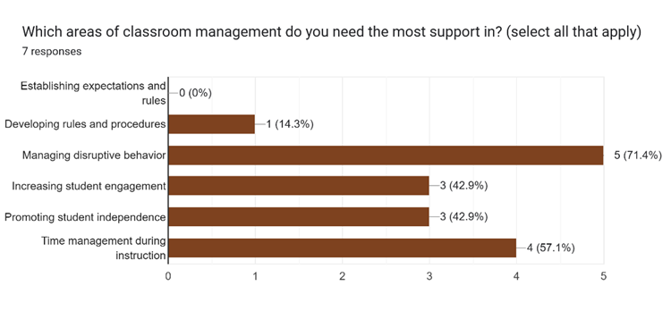
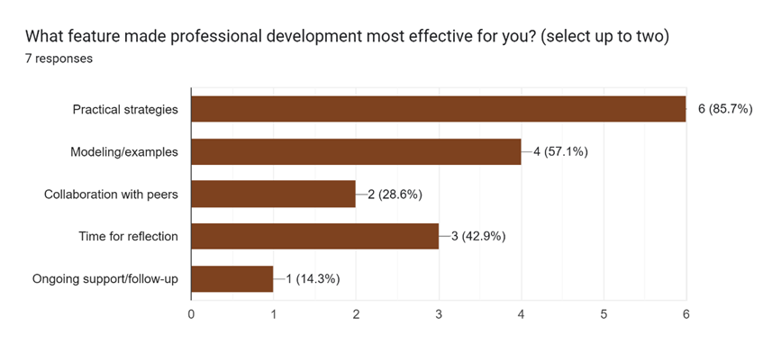
Data on Professional Development Needs
Notes:
When we look at the data related to professional development, a few key findings stand out. First, teachers reported participating in a wide range of professional development formats, including workshops, conferences, coaching, mentoring, online courses, PLCs, and in-person sessions. This shows that access to professional development is not necessarily the issue—teachers are engaging in a variety of learning opportunities. However, the data reveal that the most important factor in determining the effectiveness of these experiences was the inclusion of practical, applicable strategies. Teachers consistently identified that they benefit most from professional development that provides techniques they can immediately implement in their classrooms. Looking at areas of need, none of the seven participants selected establishing rules and expectations as an area where they needed support, which aligns with earlier data showing high confidence in that area. In contrast, more than half of the participants identified managing disruptive behavior and improving instructional time as areas where they need additional support. Finally, when examining preferred delivery methods, responses were evenly distributed across all formats. This suggests that while teachers share similar needs, they value different learning approaches. Overall, the data highlights the importance of providing flexible, practical, and targeted professional development that focuses on real classroom application.

Slide 11
Results
Improving time management during instruction, focusing on disruptive behaviors, and increases proactive and SEL strategies were the majority of teachers’ focus areas
The program should prioritize practical application
Importance of ongoing support and collaboration
Flexibility in delivery methods
Understanding underlying causes of student behaviors
Notes:
When we look at the results, several clear priorities emerge. One of the biggest areas of need is improving time management during instruction, along with better strategies for managing disruptive behaviors. More than half of the participants identified these as key challenges, showing a strong need for targeted support in these areas. The data also emphasizes the importance of understanding the underlying causes of student behavior, thereby helping teachers respond more effectively and supportively. This will increase the teacher's ability to manage the students' disruptive behaviors. The data points to the importance of shifting toward more proactive strategies, including integrating social-emotional learning. Since teachers reported a tendency toward reactive approaches, there is a clear opportunity to strengthen preventative practices that support student behavior before issues arise. Another major takeaway is that professional development needs to focus on practical application. Teachers consistently reported that the most effective training includes strategies they can immediately use in their classrooms, rather than just theory. The findings also highlight the importance of ongoing support and collaboration. Teachers benefit from opportunities like coaching, feedback, and working with peers to refine their practices over time. In terms of delivery, preferences spanned multiple formats, underscoring the need for flexibility in how professional development is offered.

Slide 12
Conclusions
Gaps in consistency with classroom management strategies
Ongoing challenges related to time management and diverse disruptive behaviors
Professional development must be intentionally designed to fill gaps
Practical, applicable, modeling, and collaboration
The impact of classroom management on education is significant
Notes:
The conclusions of this study make it clear that teachers have a strong foundation in classroom management, especially in establishing rules and procedures. However, the data also shows a gap in consistently using proactive strategies that support effective instruction. Many teachers reported relying on reactive approaches, even though they regularly use classroom management techniques. The findings also highlight ongoing challenges with managing disruptive behavior, improving instructional time, and supporting diverse learners, including students with trauma and attention-related needs. This points to a clear need for more targeted and practical professional development. Another key takeaway is that professional development is most effective when it focuses on real, applicable strategies and includes opportunities for modeling, collaboration, and feedback. The research also emphasizes that ongoing support is critical—one-time trainings are not enough to create lasting change in classroom practice. Overall, this study shows that when professional development is aligned to teacher needs and supported over time, it can lead to stronger classroom management, more engaging and structured learning environments, and improved student outcomes. It also supports teachers by boosting confidence, reducing stress, and improving classroom effectiveness.

Slide 13
Strengths and Weaknesses of Methodology
Strengths
Combined quantitative and qualitative data
Inclusion of a rubric
Direct alignment between data collection instruments and the research question
Use of open-ended questions
Weaknesses
Small sample size
Reliance on self-reported data
Lack of observational or performance-based data
Time constraints
Notes:
Looking at the methodology, several strengths strongly supported the quality of this study. One major strength was the use of a mixed-methods approach, combining quantitative survey data with qualitative responses. This allowed for both clear trends in the data and deeper insight into teachers’ experiences. The use of a rubric to analyze qualitative data also helped improve consistency and reliability by organizing responses into clear themes. Another strength was the strong alignment between the survey and the research question. The questions were designed to capture teachers’ confidence, experiences, and classroom management needs, and the open-ended responses provided more detailed, real-world perspectives. However, there were also some limitations to consider. The biggest limitation was the small sample size of only seven participants, which makes it difficult to generalize the findings to a larger population. Additionally, the study relied on self-reported data, which can introduce bias, as responses may not always fully reflect actual classroom practices. Another limitation was the lack of observational data. While the survey provided valuable insights into teacher perceptions, it did not include direct observation of classroom management in practice. Overall, while the methodology provided meaningful and relevant findings, future research could be strengthened by including a larger sample size and additional data sources.

Slide 14
Influential Factors
Small sample size
Variation in teaching experience
Reliance on self-reported data
Context
Time constraints
Prior exposure to professional development
Notes:
When reviewing the results of this study, several influential factors should be kept in mind. First, the small sample size of just seven participants means that each response had a greater impact on the overall findings, potentially limiting the breadth of the results. In addition, participants had a range of teaching experience, from newer teachers to those with over 10 years in the field, which likely influenced differences in confidence and perspectives. Another important factor is that the data were self-reported. This means responses may not always fully reflect actual classroom practices, and some participants may have answered in ways they felt were expected rather than completely accurate. Context also played a role. Classroom management can vary depending on student needs, classroom dynamics, and the school environment, including factors such as school culture and administrative support. These variables likely influenced how teachers responded. Time constraints may also have affected the depth of responses, especially for open-ended questions, as teachers may not have had time to elaborate on their experiences fully. Finally, differences in prior professional development likely shaped participants' perceptions of their preparedness and needs. Overall, these factors are important to consider when interpreting the findings and applying them to broader settings.

Slide 15
Areas of Further Investigation
Conduct research with a larger more diverse sample size
Examining the effectiveness of models over time
Study the implementation of SEL strategies
Incorporate observational or performance-based data in future studies
The role of administrative support and school culture in classroom management
Notes:
When we look at areas for further investigation, several important next steps emerge from this study. One key area is expanding the research to include a larger and more diverse group of teachers across different grade levels and school settings. This would help provide a clearer picture of how classroom management needs vary across contexts. Another important area is examining the long-term impact of professional development. Future research could examine how ongoing supports such as coaching, mentoring, and professional learning communities influence teachers’ ability to implement proactive strategies over time. There is also a need for more research on integrating social-emotional learning into classroom management. Since SEL was identified as an area of need, future studies could examine how specific SEL strategies affect student behavior, engagement, and the overall classroom climate. Additionally, incorporating observational data would strengthen future studies. Actually observing classroom practices would provide a more objective view of how strategies are implemented, rather than relying only on self-reported data. Finally, future research could explore the role of administrative support and school culture. Understanding how leadership and school-wide systems impact classroom management could help create more supportive environments for teachers. Overall, these areas would help build on this study's findings and provide deeper insight into effective classroom management and professional development.

Slide 16
Thank you!
I hope you have a wonderful day!
Notes:
We have now concluded my presentation. Thank you for your time, and I hope you have a wonderful day.

